Slide 1

Presentation on
Restaurant management
Website
BACHELOR OF ENGINEERING
COMPUTER SCIENCE & ENGINEERING
Submitted to: Submitted By: Shobit Choudhary
Mr. Mudassir Sir 2100681540043
Harsh Verma
2100681540021
Harsh Tyagi
2100681540020

Slide 2


Introduction :-
.
"Online Restaurant Website” is considered as an increasingly used application in restaurant management. Just a few years ago, people used to spend long time waiting for a table to be ready for them at a restaurant. And after that, they would wait longer time to order their food.

Slide 3

Objective :-
The principal objective of your website should always be to attract customers to your restaurant and as such an online booking function is the most essential feature. This may lead to another page with your restaurant's opening times and telephone number for those wanting to make reservations by phone or physically placing of order.

Slide 4


Technology used :-
HTML:- The HyperText Markup Language or HTML is the standard markup language for documents designed to be displayed in a web browser. It can be assisted by technologies such as Cascading Style Sheets and scripting languages such as JavaScript.
CSS :- Cascading Style Sheets is a style sheet language used for describing the presentation of a document written in a markup language such as HTML. CSS is a cornerstone technology of the World Wide Web, alongside HTML and JavaScript.

Slide 5
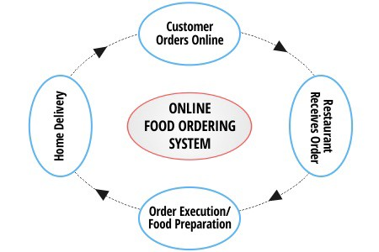
DFD Level 0

Slide 6
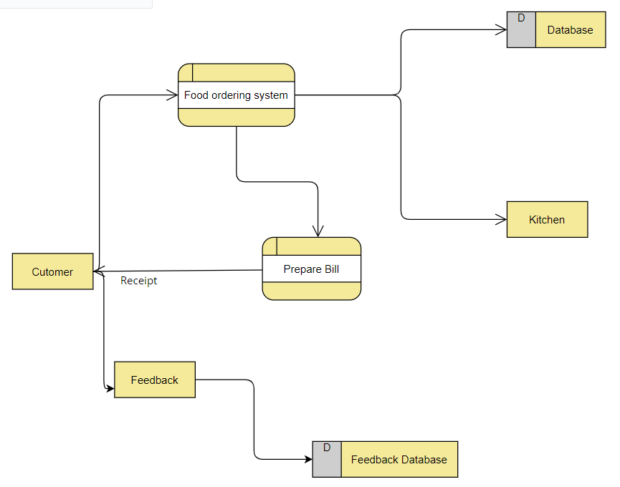

Slide 7
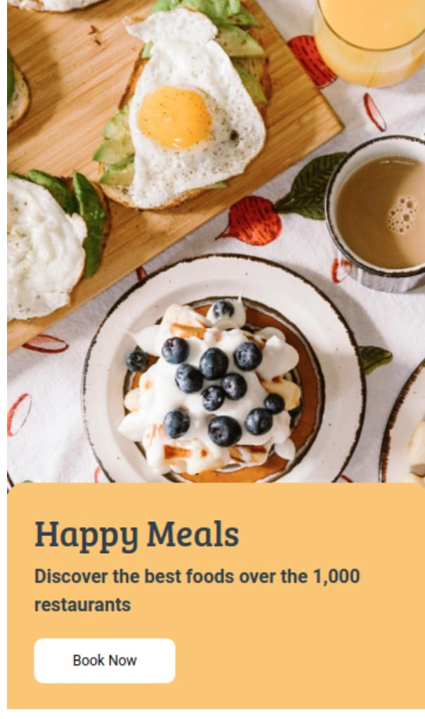
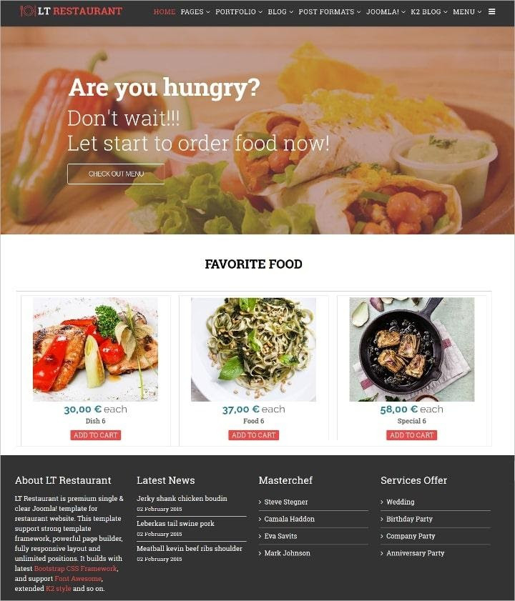
This is the front page of our website which shows a navigation bar to the customer from where he can switch to different features of the website .
This part of website shows the special items of the restaurant . Which also includes a part of CSS which on hover shows the picture of food item .

Slide 8
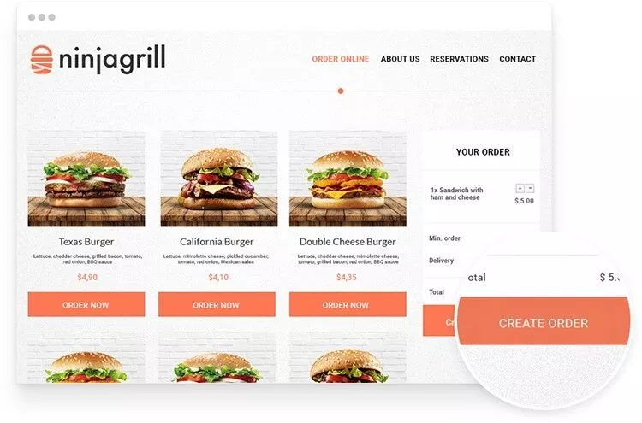
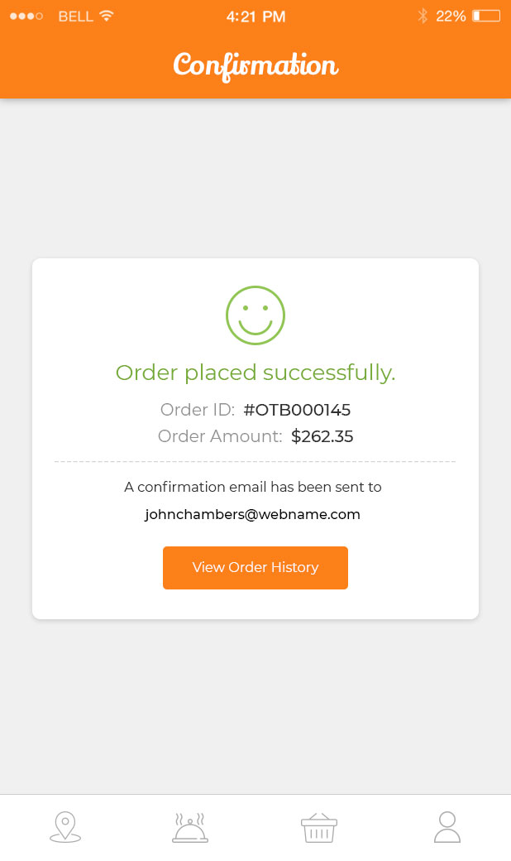
.
This part includes variety of food items for order placed by customer among of there favorite items.
This shows confirmation of order place

Slide 9
Thank you .

